Slide 1
Time & Labor An introduction into completion of the Configuration Workbook
September 2019

Slide 2
Understand Time and Labor & Key Words
Review the Purpose & Content of the Time and Labor Configuration Workbook
Learn to complete the Tabs within the Time and Labor Configuration Workbook
Recap of Next Steps

Slide 3
Time and Labor, commonly referred to as Time, is a web-based module within HCM that allows employees, managers and administrators methods of time entries and management of those items.

Slide 4
The Lingo
HCM – acronym for Human Capital Management. This is the source of record for all employee demographic information
TLM – acronym for Time and Labor Management
API – Applicant Programming Interface (this is the real time integration of the HCM environment into TLM)
Integrate – to coordinate or bring together field populations
Dashboard – control panel for content management or web page
Configuration – define values of structure and/or parameters
Module – additional option/product to increase capabilities of Time and Labor
Policy – sets of rules and guidelines formulated by your company to define time management

Slide 5
The purpose of the Time and Labor Configuration Workbook is used to collect and understand your payroll policies and rules for time records to pay your employees.

Slide 6
The Time and Labor Configuration Workbook Tabs
Contact Information: Enter basic company information
Shift Differentials: Enter shift settings for employee work cycles
Integration Fields: Enter data for employee records that will be combined from systems
Hardware: Enter any time clocks devices and locations
General: Enter all necessary settings for system set-up
Schedule Templates: Enter schedules featured in time and labor
Preference Policies: Enter behaviors for employee and manager dashboards
Scheduled Exception Alerts: Enter alternate hours outside of set employee schedules
Holidays: Enter current company paid holidays
Labor Levels: Enter structure for labor distribution, job costing, and reporting
Payroll Policies: Enter rules to calculate time including overtime, breaks, etc.
Pay Types: Enter data to collect and record type of payment reflected on timecards
Security: Enter settings for system administrators and IP addresses to track
Additional Modules: Includes list of add-on modules for additional cost

Slide 7
Complete the Contact Information Tab in the Time and Labor Workbook

Slide 8
Company & Contact Information
Enter company information on this tab
This company information will represent your Time and Labor environment for all users and is not specific to individual FEIN’s
Enter contact information for the following individuals in your organization:
Main Contact (Decision Maker)
Alternate Contact (in the event the Decision Maker is not available or unresponsive)
IT Contact – this is required if installing any hardware and internal firewall setup is involved

Slide 9
Company & Contact Information
Time Entry Methods
Provide answers to questions on how the employees will be entering time
What method will the employees use to enter time?
Time clocks
How many Time Clocks will be needed?
Web Punching
Kiosks
How many employees will be punching or entering time on a regular basis?
What do we do today for managing time entry methods for our employees?

Slide 10
Determine individual internal employees responsible for completion of workbook
Define decision maker and additional contacts
Define clock methods to be used by employees
Identify how time is being managed today? Who is the current expert on policies internally.
Next Steps:
Contact Information

Slide 11
Complete the Integration Fields Tab in the Time and Labor Workbook

Slide 12
Integration Fields
The TLM environment will have many integrated data fields for employee records that are managed from their HCM records.
There are several required fields indicated on this tab of the worksheet. You may select any additional data elements to include in the integration for your environment.
Required Fields:
Employee Number
First Name
Last Name
Middle Name
Time Zone Key
(based on EE’s zip code)
FLSA Status (managed by the job in HCM)
Hourly or Salary (managed by the job in HCM)
Date of Last Hire/Original Hire
Employment Status
Employment Status Start Date

Slide 13
Review list of available data fields for integration
Brainstorm on what additional fields you want or need included in the integration list to TLM
Next Steps:
Integration Fields

Slide 14
Complete the General Tab in the Time and Labor Workbook

Slide 15
General Configuration Tab
Global System Settings
There are five items in this section to be completed. The first four are defined for all databases in HCM:
Clock Pin
“Labor Level” Description
“Labor Levels” Description
No. of days to generate schedules in advance
Time card approval levels
The Time Card Approval Levels section defines the level of approvals required for time cards:
Use the drop down to select from the options available
A time card must be fully approved by all levels before it is included in the time export for payroll processing

Slide 16
General Configuration Tab
Miscellaneous Settings
There are ten questions in this section to be reviewed and completed. There are notes indicated with each question and those that have recommendations.
Check each one that you are interested in having enabled in your environment:
Email Import Process Log
Allow Approvals with Missing Punches (NOT recommended)
Send Email to Admins if an Employee without a manager Requests Time Off (recommended)
Enable Employee Group Hierarchy (recommended)
Enable Labor Level Hierarchy
Show All Rates as Hourly Rates
Allow Second Manager to approve as a Manager1
Remove Employee Approvals on Manager Edit
Send Separate Emails to Each Recipient

Slide 17
General Configuration Tab
Miscellaneous Settings
Payroll Seniority Date Calculation
This data field controls and drives how the holiday is auto generated on an employee timecard.
You may use one of the below date fields within TLM to manage this item
Employee Start Date (original hire date or seniority date)
Employee Recent Active Date (rehire date not the seniority date)
Total number of days employee active (if probation period defined – will reduce probation period from Hire date )

Slide 18
General Configuration Tab
Default User Group Name
Drives security and how a manager will be able to see the timecards for their direct or indirect reports
There are three options available:
Group – Employee Identifier
Manager’s Name (recommended)
Manager’s Home Labor Level Description (select Labor Level from drop down list)
Hierarchy Defaults
This feature works with the Group – Employee Identifier option above (Cascading Supervisor)
There are three options available :
Subordinate Group Access
Assign Group Managers
Assign Proxy Manager (recommended)
Admin User Settings
Define time zone of the corporate location or where payroll is being processed/managed

Slide 19
Identify Approval levels on timecards in place today, determine if same rules will apply in HCM
Review hierarchy needs for timecards
Review security needs for timecards
Next Steps:
General Configuration Info

Slide 20
Complete the Preference Policies Tab in the Time and Labor Workbook

Slide 21
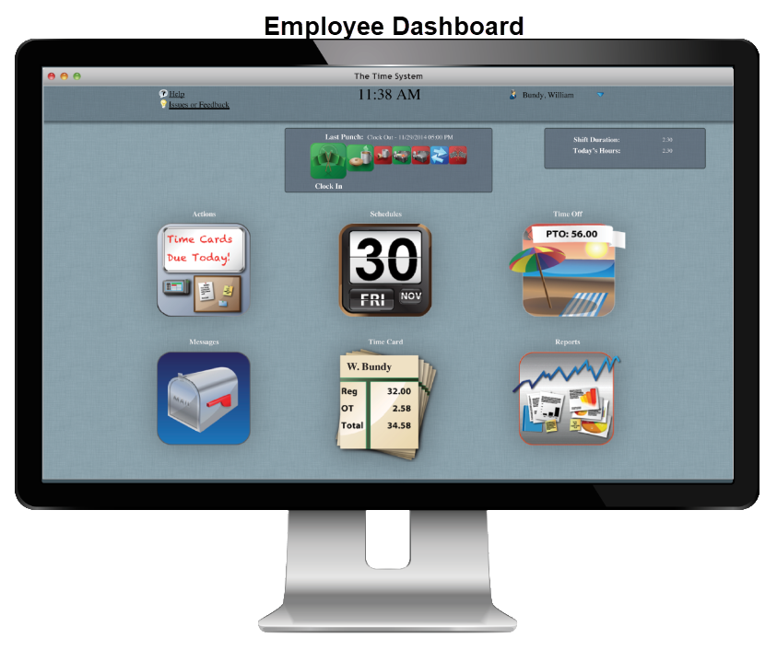
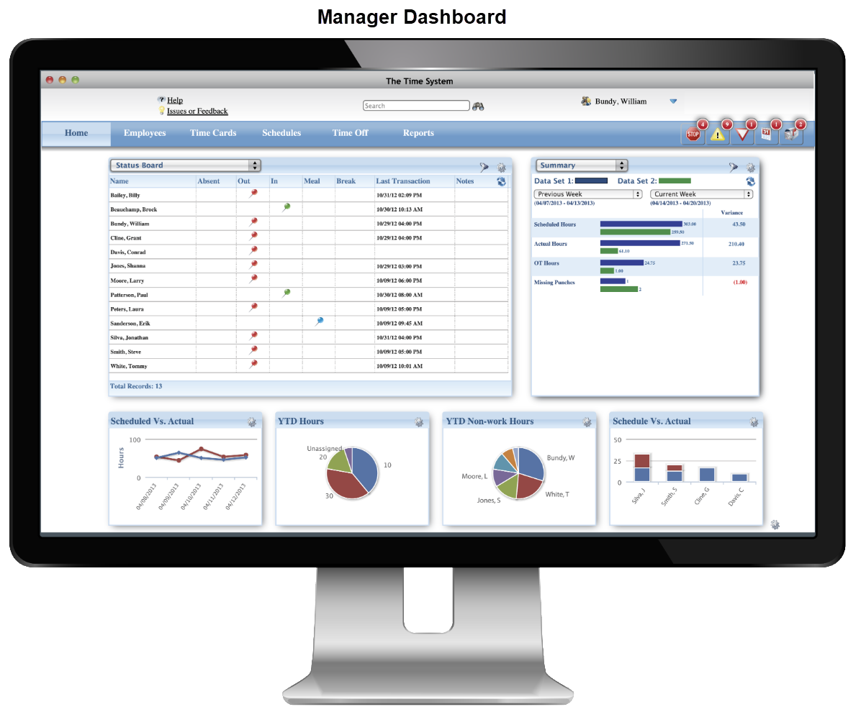
Preference Policies
What is a Preference Policy?
Preference Policies: Define behaviors for the users in the employee and manager dashboard Controls what functions will be available on unique dashboards

Slide 22
Preference Policies
Actions within a Preference Policy for Employees:
Actions within a Preference Policy for Managers:
Employee messaging
Transfer
Time duration view (decimals/minutes)
Timesheet entry
Schedules
Time off balances and/or requests
Timecard approvals
Reports
Missed Punches
Time off calendar with all employees
Status board
Schedules
Schedule Templates
Attendance Exceptions (schedules must be in use)
Edit Timecards
Timecard Approvals
Reports

Slide 23
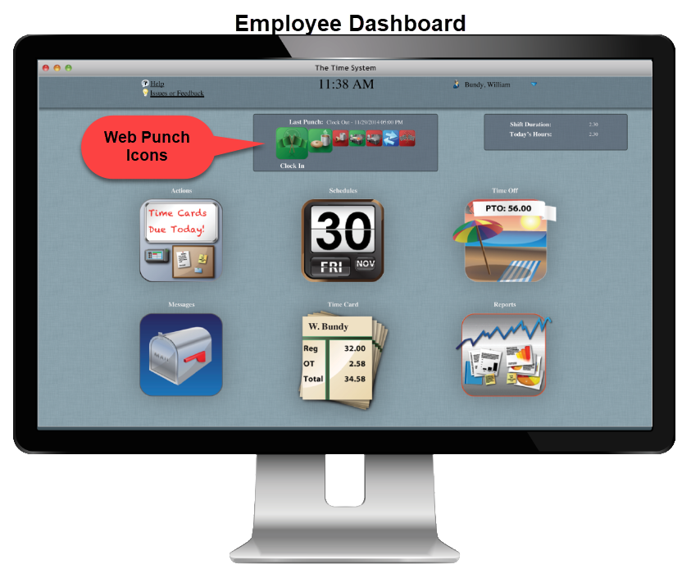
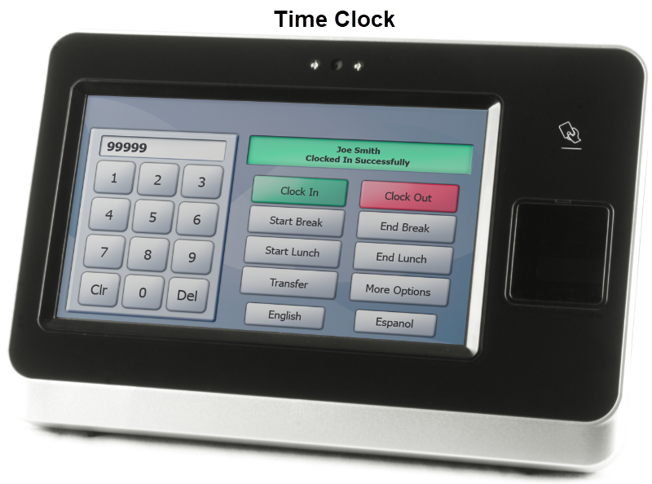
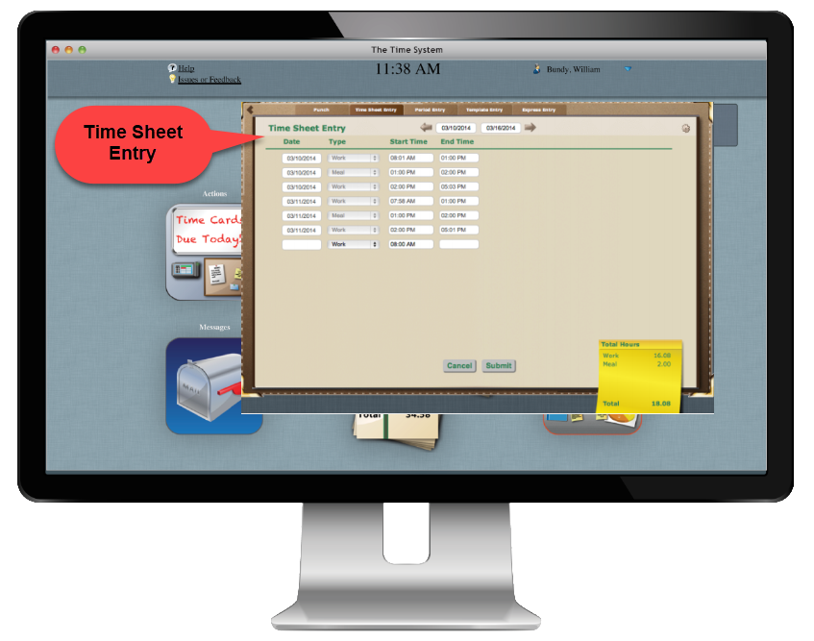
Preference Policies
Why is this cool?
Some employees may use a computer for web punch method, time sheet entry vs. a time clock

Slide 24
What functions do you want employees and managers to own on their dashboards?
Will you want multiple policies configured?
Next Steps:
Preference Policies

Slide 25
Complete the Holidays Tab in the Time and Labor Workbook

Slide 26
Holidays
Holidays
Populate worksheet tab with all company paid holidays for current year
Client is responsible for generating Holiday dates in TLM system for all future calendar years.
This step is part of the Year End project task list with instructions included

Slide 27
Identify company list of all paid holidays
Determine internal administrator that will manage entry of holidays in future calendar years
Next Steps: Holidays

Slide 28
Complete the Payroll Policies Tab in the Time and Labor Workbook

Slide 29
Payroll Policies
A Payroll Policy is a collection of rules used to calculate time for a group of employees and used to define:
Overtime
Breaks
Meals
Additional payroll actions
A Payroll Policy cannot be deleted if it has been used to calculate time:
Define pay periods, the start and end of the pay period, pay frequency (weekly, bi-weekly, semi-monthly, or monthly)
This will effect pay periods and when Overtime rules will reset
All Employees in the system must be assigned to a Payroll Policy

Slide 30
Schedule Rounding
There are two types of Rounding that are available:
Round to Schedule: When clocking in or out, the employee's time can be rounded to his/her schedule if the entry falls within an acceptable "window "
Standard Rounding: When a clock-in or clock-out transaction does not fall within the Round To Schedule window, a standard rounding policy can be applied
Overtime Rule Assignment
Each Overtime Rule that applies to employees on this Payroll Policy should be added:
Weekly Overtime
Consecutive Days Overtime
Specific Consecutive Days Overtime
Daily Overtime
Holiday Overtime
Other Overtime Exceptions

Slide 31
Holiday Rules
Holidays are generated during time sheet processing to define:
Rules for Paid and Unpaid holidays
Minimum and maximums for holidays
Qualifications to earn holiday hours
Rules for worked holiday time
Minimum and maximums for worked holiday time
Meal Rules
There are several ways of granting employees meal periods during their shifts. Any meal in a shift will follow the rules for each meal you define:
Manual clock in/out for meal – an employee manually clocks in/out for a meal. (ie., employees must work a minimum of 30 minutes before clocking out for a meal)
Auto Meals – the system automatically subtracts meal time from employee’s shifts

Slide 32
Break Rules
There are several ways of granting employees break periods during their shifts. Any break in a shift will follow the rules for each break you define.
Timesheet Processing Rules
Define additional rules to time processing such as:
How to count time when crossing –midnight **Example below
Automatically reject duplicate punches or set time limit between punches
Average shift length an employee may work
Opposing punches
Maximum shift length of time an employee may work before notification to manager/admin team

Slide 33
Review current internal policy documentation on timecard, overtime, holidays, breaks and meal rules
If union organization, review union contracts for timecard, overtime, holidays, breaks and meal rules
Identify internal Subject Matter Expert(s) on timecard policies
Next Steps:
Payroll Policies

Slide 34
Complete the Security Tab in the Time and Labor Workbook

Slide 35
Security
Used to manage administrators of TLM environment and track IP addresses
List Administrators for TLM Environment on this section of the worksheet
If using IP Filtering to manage access to TLM web page provide full list of IP addresses or ranges for organization (not required)

Slide 36
Define internal administrators for TLM
Gather IP address range list from internal IT Department
Next Steps: Security

Slide 37
Complete the Shift Differentials Tab in the Time and Labor Workbook

Slide 38
Shift Differentials are used when an employee is paid more based on the shift they work. The base pay rate would be paid plus additional monies defined in this section.
There are several items to consider if your organization offers differentials:
Shift Differentials
Are the Shift Differentials overlapping?
Is there a differential for overtime?
Add differential after calculating overtime?
Specific date/time for the differential?
Additional $ or % for differential?
Minimum number of minutes to work in differential to receive differential payment?
Differential rounding to clock in/out? Majority of hours?
Differentials apply to holidays?

Slide 39
Determine if you need shift differentials defined
Determine number of unique differentials needed
If union organization, identify documented shift differential policies
Next Steps:
Shift Differentials

Slide 40
Complete the Hardware Tab in the Time and Labor Workbook

Slide 41
Hardware
If employees will be punching in and out using a time clock device, each hardware device needs to be registered in the portal with a location
List each Site Location and Name of clock on this tab of the worksheet
For example – if your Orlando office location has two clocks, one on the first floor and one on the second floor. You could label them:
“Orlando – 1st Floor”
“Orlando – 2nd Floor”

Slide 42
Determine location of each time clock
Determine alias name for each time clock
Next Steps: Hardware

Slide 43
Complete the Schedule Templates Tab in the Time and Labor Workbook

Slide 44
Schedule Templates
Populate if using schedules feature in time and labor
Maintained by Administrator or Manager if Schedules feature is in use
Once schedules are established, managers or administrators are responsible for assigning a schedule to employee records. Assignments can be mass updated using filters and assigned values in the employee records

Slide 45
Gather unique list of all schedules for organization
Collect list of unique schedule templates needed from administrator and manager population
Next Steps:
Schedule Templates

Slide 46
Complete the Scheduled Exception Alerts Tab in the Time and Labor Workbook

Slide 47
Scheduled Exception Alerts
Populate if using Schedule Templates – will not work without Schedule Templates
Exceptions occur when employees punch outside of their scheduled hours.
Multiple Exception Policies can be setup that may differ for specific schedules.
They do not affect payroll, but the Manager or Administrator must check off a notification box when an alert is received.

Slide 48
Identify the type of exceptions your organization wants to track
Determine time exceptions minimums to be alerted on
Next Steps:
Schedule Exception Alerts

Slide 49
Complete the Labor Levels Tab in the Time and Labor Workbook

Slide 50
Labor Levels:
Used to create structure for Labor Distribution, Job Costing and reporting
These values will be the same as reported to your HCM implementation team
Any new values setup in HCM must also be setup and managed in TLM by the Administrator

Slide 51
Gather list of Labor Levels needed in TLM
Determine if any Labor Levels needed in TLM are not in HCM
Next Steps:
Labor Levels

Slide 52
Complete the Pay Types Tab in the Time and Labor Workbook

Slide 53
Pay Types
Pay types are used to collect and record the type of payment reflected on timecards.
For Example: Regular, Overtime, Holiday, PTO, Vacation, etc.
These are the earning codes in your HCM environment

Slide 54
Gather list of earnings needed for timecards
Compare list of earnings needed for timecards to the values provided to HCM for payroll processing
Next Steps:
Pay Types

Slide 55
Complete the Additional Modules Tab in the Time and Labor Workbook

Slide 56
Additional Modules
Reflects a list of add on modules of time and labor that are available for an additional cost. Consult with your TLM Specialist if interested in any of these features.
Mobile Interface
Web Kiosk
Telephony/IVR (Integrated Voice Recognition)
Points Tracking
Forecasting
Advanced Scheduler

Slide 57
TLM Configuration Workbook

